Slide 1
Weather Forecasting System in Java
A city-based temperature tracking and forecasting tool
Developed using Java

Slide 2
Abstract
Objective:
To build a system for managing city-wise temperature records with features like:
- Adding, deleting, and updating cities.
- Storing and displaying current and previous day temperatures.
- Inserting records at specific positions.
Key Features:
- Conversion of temperatures from Celsius to Fahrenheit.
- Validation for invalid cities or positions.

Slide 3
Methodology (Part 1)
Key Variables:
- ArrayList cities: Stores city names.
- ArrayList temperatures: Stores current temperatures.
- ArrayList previousDayTemperatures: Stores previous day temperatures.
Main Methods:
- addCity(String, double): Adds a new city with temperature.
- updateTemperature(String, double): Updates temperature and saves the previous day’s record.
- deleteCity(String): Deletes a city and its records.

Slide 4
Methodology (Part 2)
Additional Methods:
- insertCityAtPosition(String, double, int): Inserts a city at a specified position.
- convertToFahrenheit(double): Converts Celsius to Fahrenheit.
- displayCityTemperature(String): Displays current temperature for a city.
- displayPreviousDayRecord(String): Shows the previous day’s temperature for a city.

Slide 5
Features and Validations
Features:
- Displays all records with city names, current, and previous temperatures.
- Robust input handling for invalid or duplicate entries.
- User-friendly menu-driven interface for operations.
Validations:
- Prompts if a city is not found.
- Ensures valid positions for record insertion.
- Ensures safe updates without data loss.

Slide 6
Advantages
Efficiency:
- Stores and retrieves city temperature records quickly.
Flexibility:
- Allows insertion at specific positions and previous day tracking.
Usability:
- Converts temperatures for better user comprehension.
- Handles invalid operations gracefully.

Slide 7
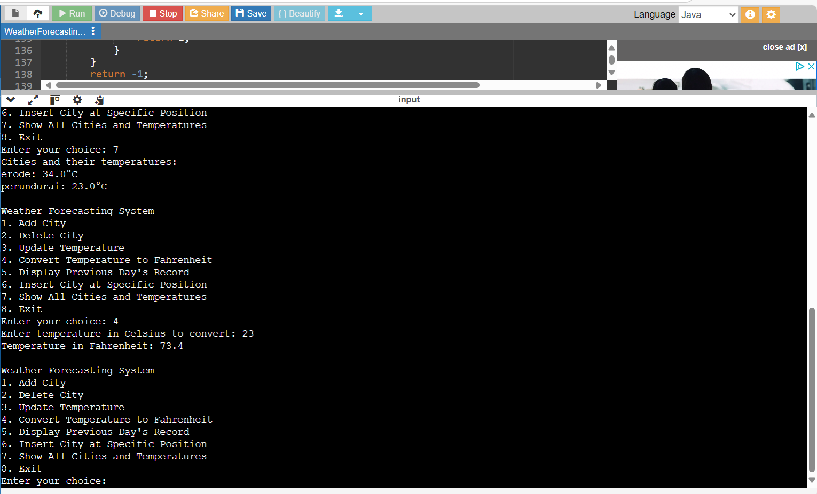
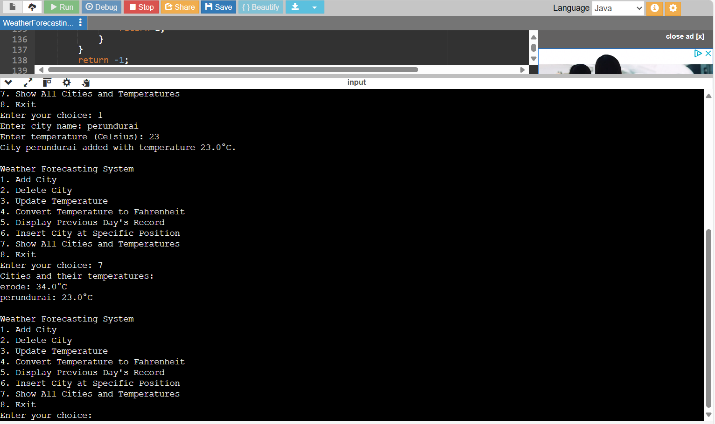
OUTPUT

Slide 8
REFERRENCE link
https://github.com/Dhanraj577765/Weaather-forecasting-system/blob/main/java.kamalam.txt
THANK YOU

